Slide 1
Arduino Based mini bot using Android App
Prepared by
Rutvik Patel(16IT090)

Slide 2
Project Overview
I am going to build a remote controlled car using Arduino UNO board and some other components. This car has basically four functions that can be controlled by Android app. Those are move forward ,Turn Right ,Turn Left and Reverse.

Slide 3
Required Components
Component Quantity
Arduino 1
L293D DC Motor Driver IC 1
DC Motors(12V or 9V) 2
Batteries(12V or 9V) 1
HC05(Bluetooth Module) 1
Male to Female Wires 5-7

Slide 4
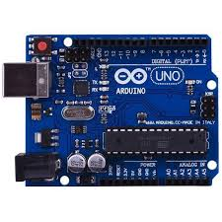
Arduino
Arduino Uno is a microcontroller board.
There are total 20 pins.
It has 14 digital input/output pins.
It works on 16MHz
Simply connect it to a computer with a USB cable to get started.

Slide 5
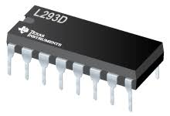
L293D
It is a motor driver IC.
It is designed to provide bidirectional drive currents of up to 600-mA at voltages from 4.5 V to 36 V.

Slide 6
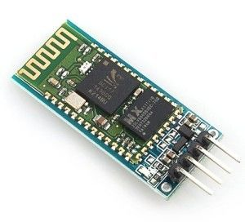
HC05(Bluetooth Module)
It is a wireless technology for exchanging data over short distance.
Range is approx. 10m

Slide 7
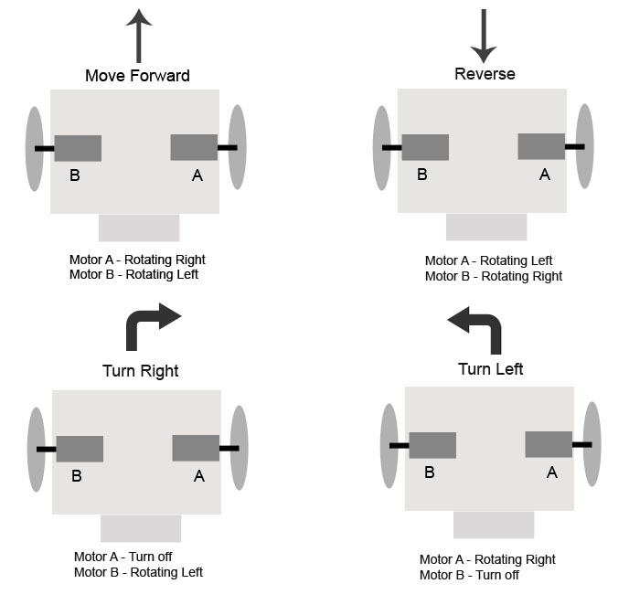
How to control the car based on Bluetooth?

Slide 8
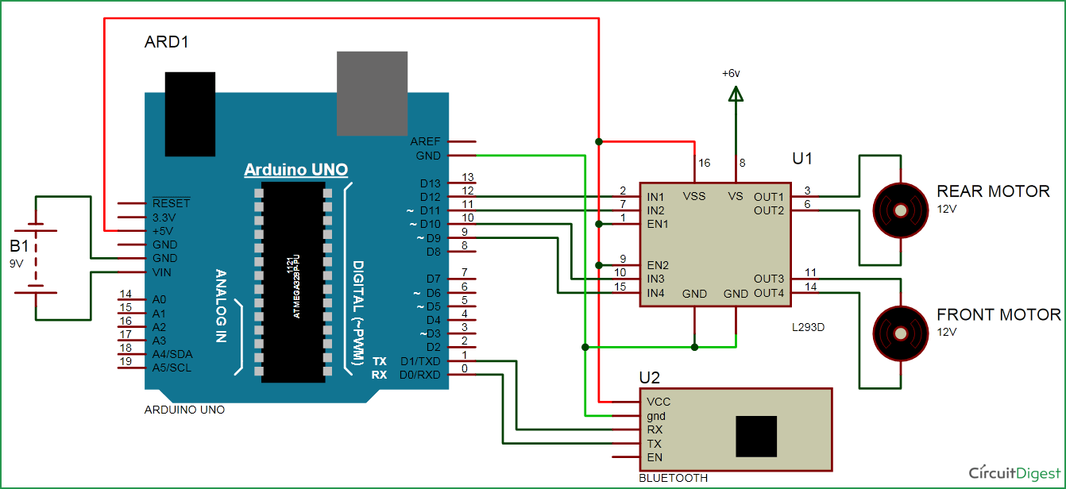
Arduino-L293D Connectivity

Slide 9
Arduino-L293D Connectivity
Connect 4 input pins of L293D to pin number – 9,10,11,12 of Arduino UNO.
We have to give +5V to both the enables of L293D and VSS.
Connect 2 motors of +12V to the output of L293D.

Slide 10
Table : Arduino-L293D Connectivity
Transmitter Button Receiver Terminal Arduino Connector
A D2 2
B D0 3
C D3 4
D D1 5
L293D Pin Name L293D Pin Number Arduino Connector
EnA 6 8
ln1 5 11
ln2 7 12
EnB 11 13
ln3 12 9
ln4 10 10

Slide 11
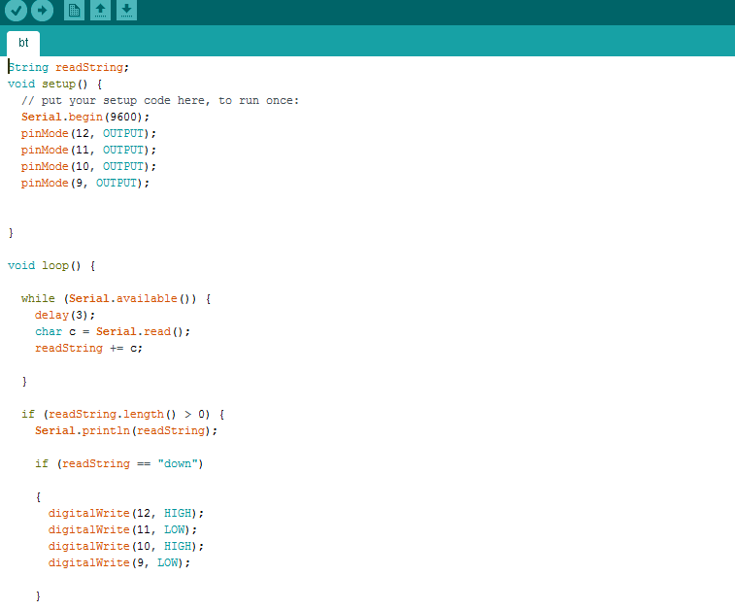

Arduino UNO Code

Slide 12
Reference
http://csharpcorner.mindcrackerinc.netdna-cdn.com/UploadFile/167ad2/how-to-use-hc-05-bluetooth-module-with-arduino/Images/Bluetooth%20Module.com
https://www.google.co.in/search?q=IR+sensors&source=lnms&tbm=isch&sa=X&ved=0ahUKEwiiqb-QxIPSAhVLwI8KHacvCR4Q_AUICCgB#tbm=isch&q=hc+05&imgrc=zws5Yq6zp1j-gM:
You Tube

Slide 13
Thank You

